Slide 1
“You’re still on the fastest route. Would you like to proceed?”
Investigating changes in primary health care access in Hawke’s Bay, New Zealand, following Cyclone Gabrielle
Grace Sokolow
April 2024

Slide 3
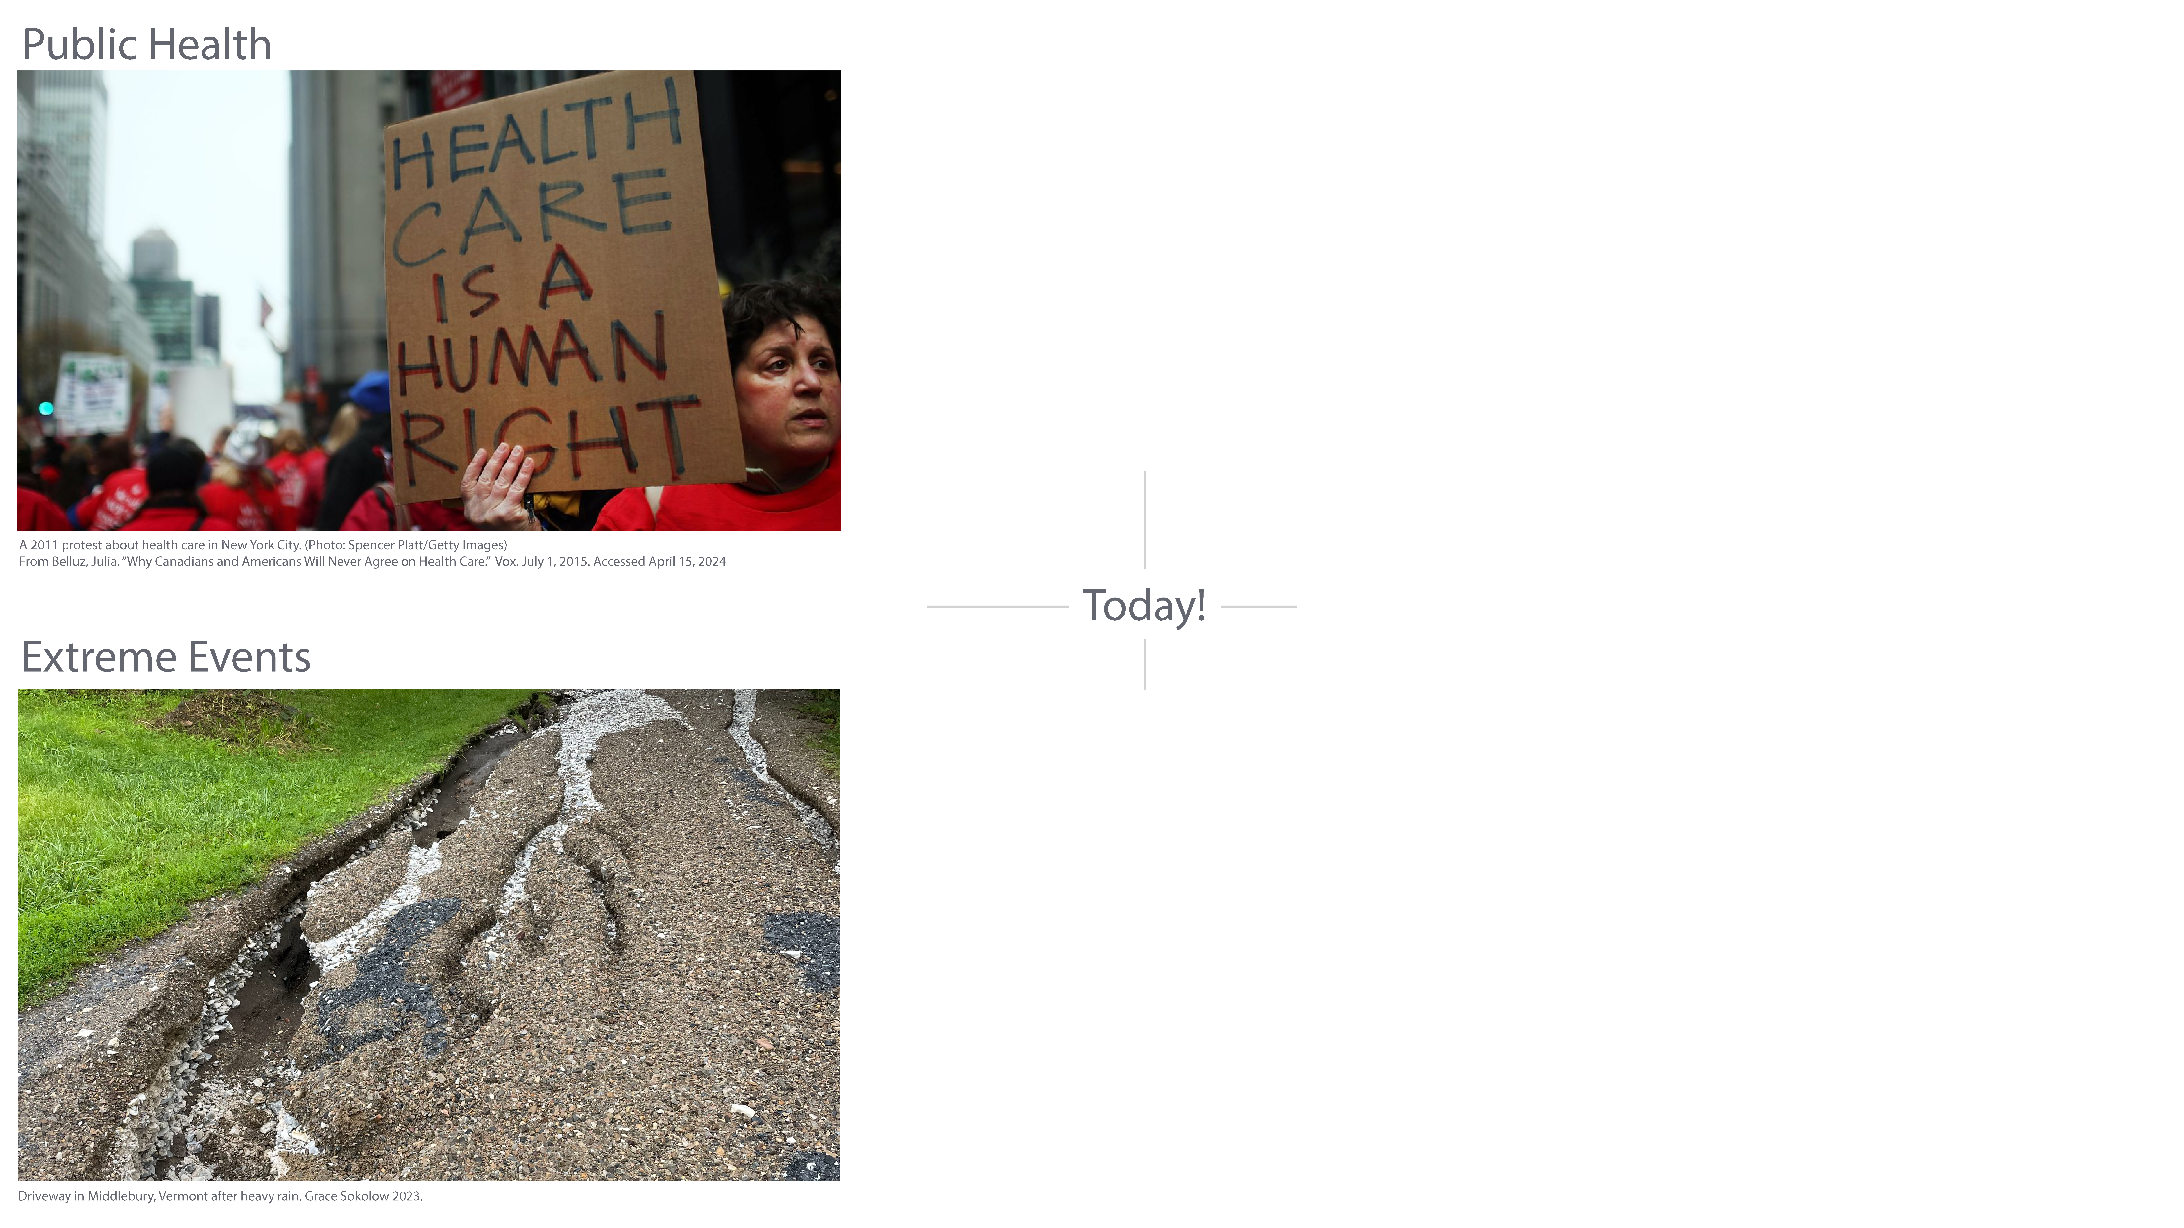

Slide 4
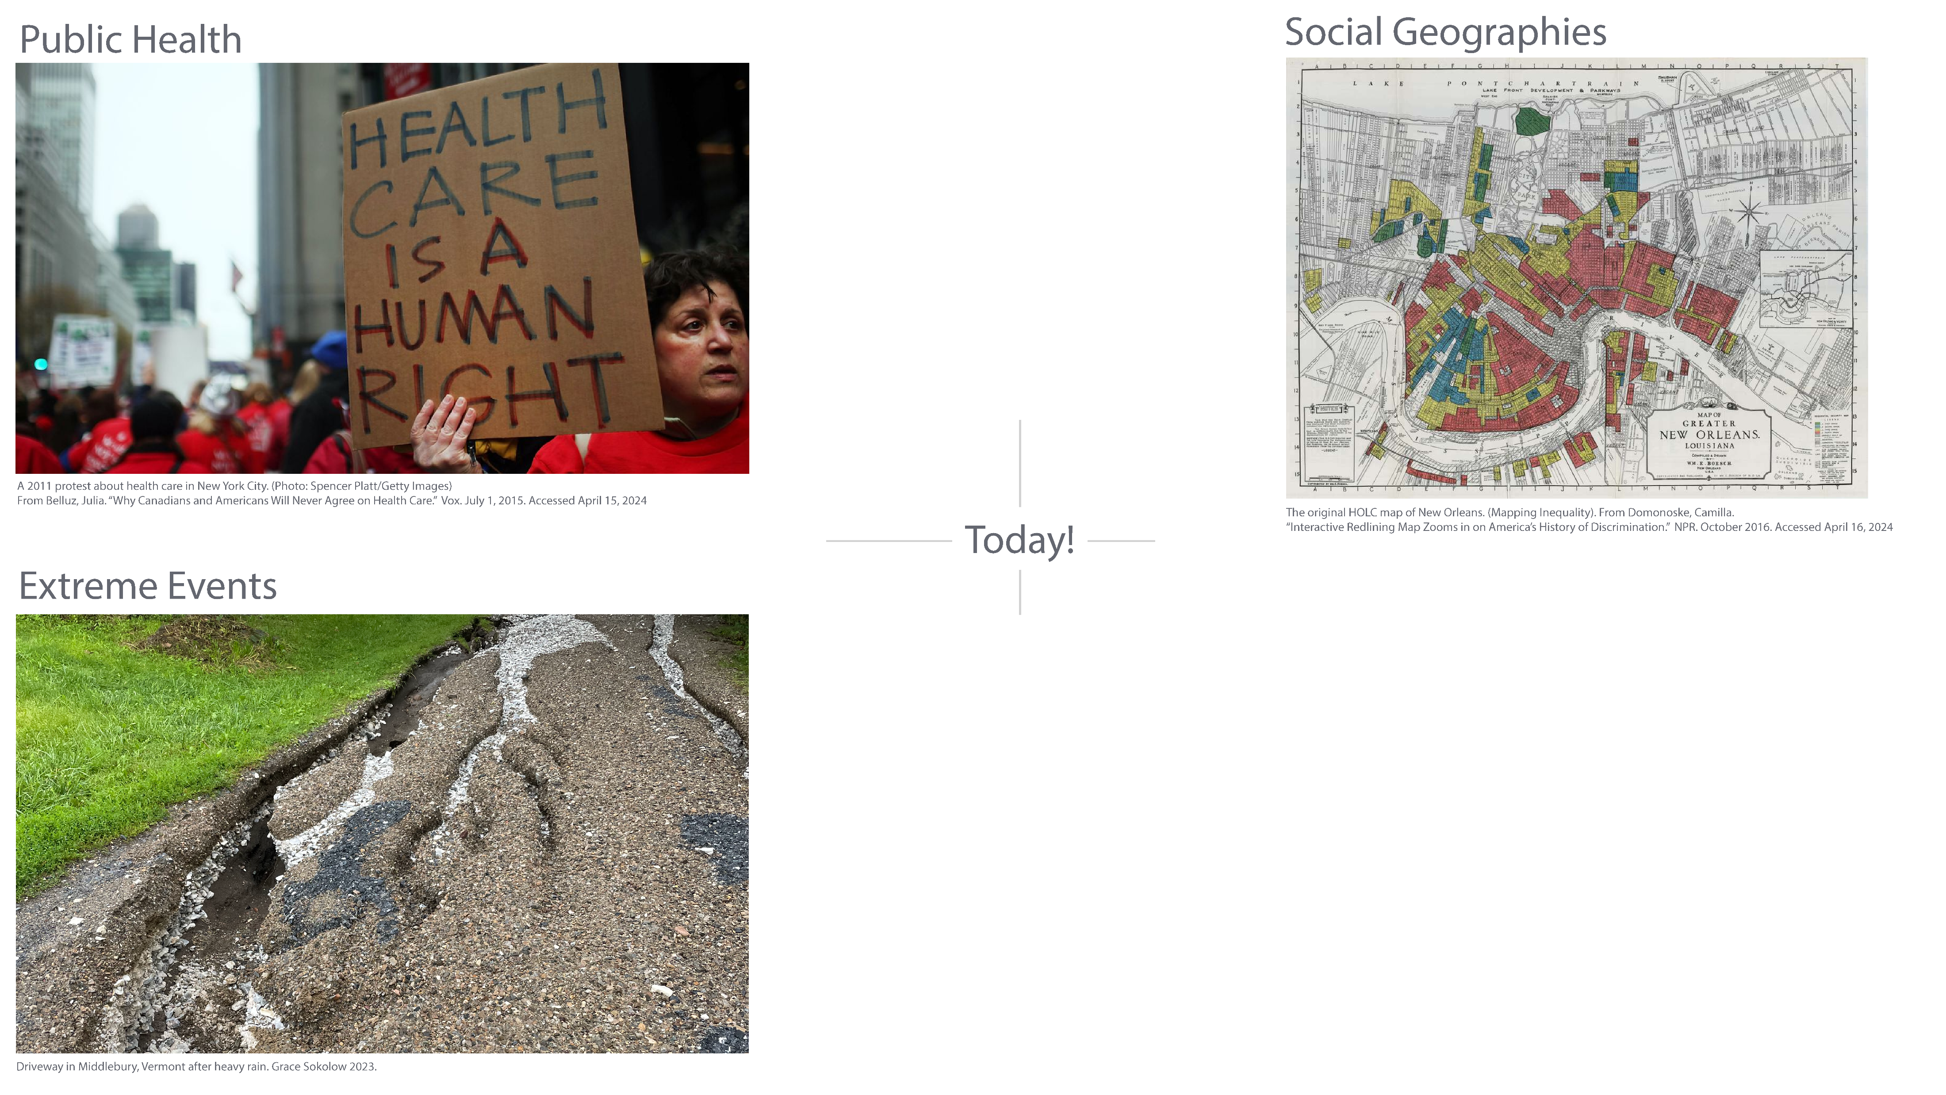

Slide 5
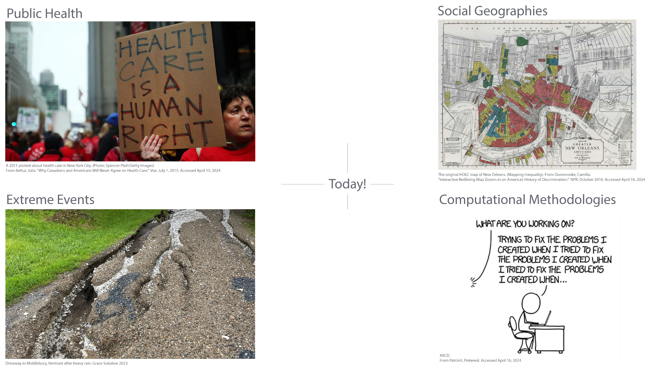

Slide 6
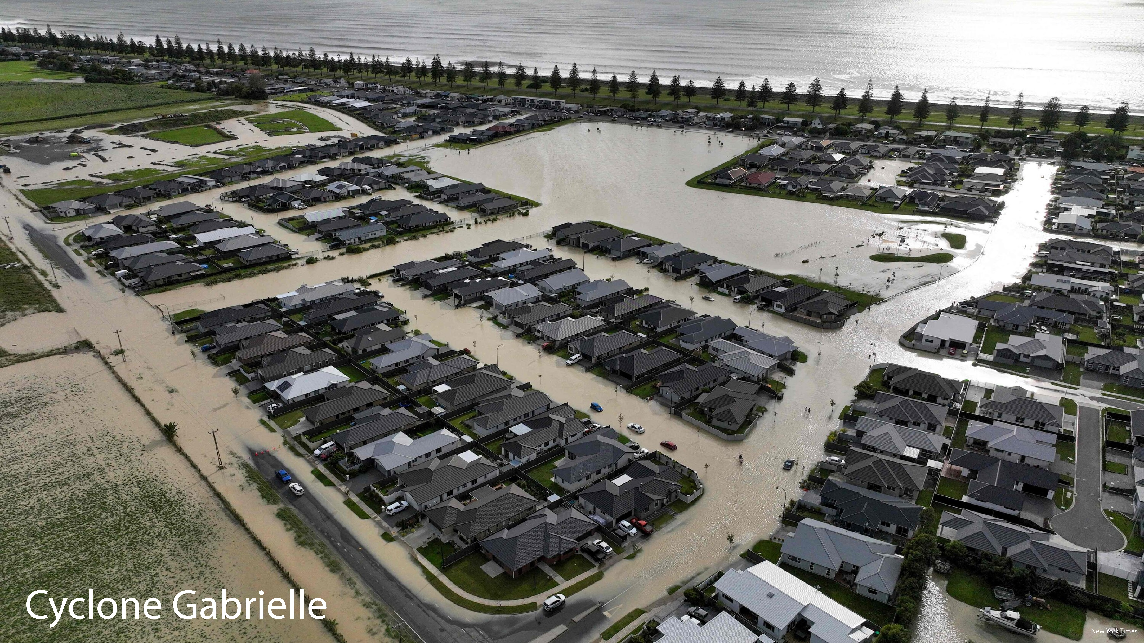

Slide 7
Research questions
1. How did road access to primary health care facilities change before and after Cyclone Gabrielle?
2. What characterizes the communities affected?

Slide 8
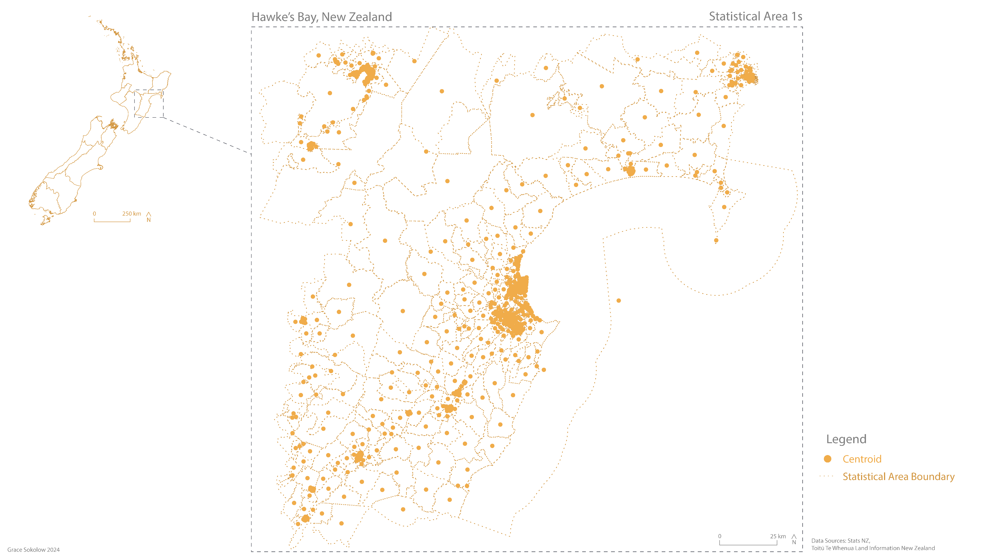

Slide 9
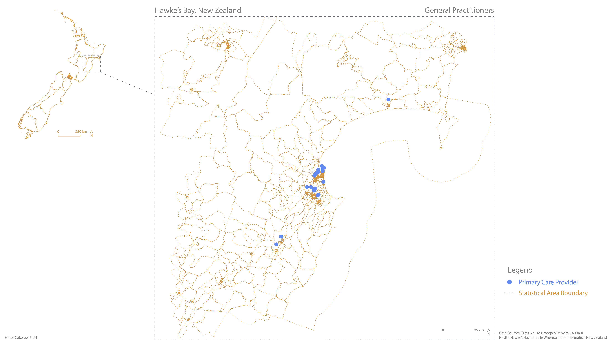

Slide 10
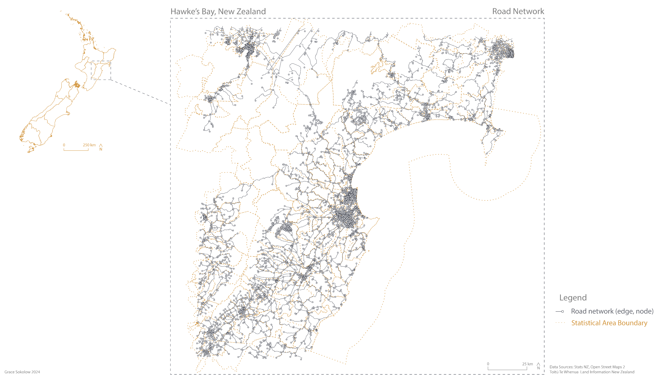

Slide 11
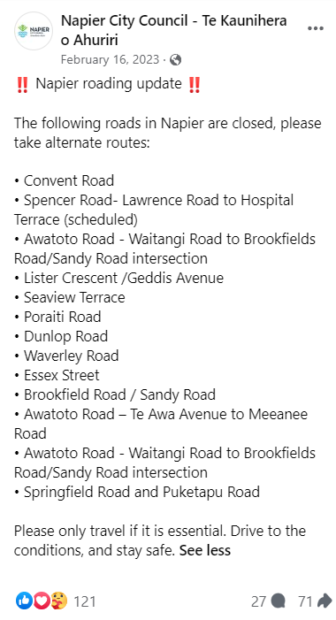
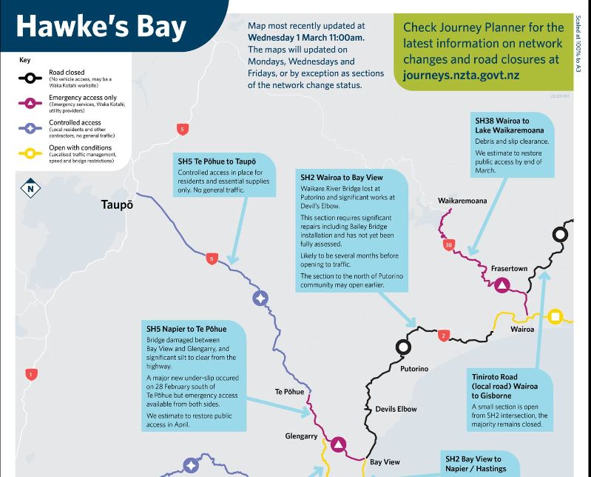
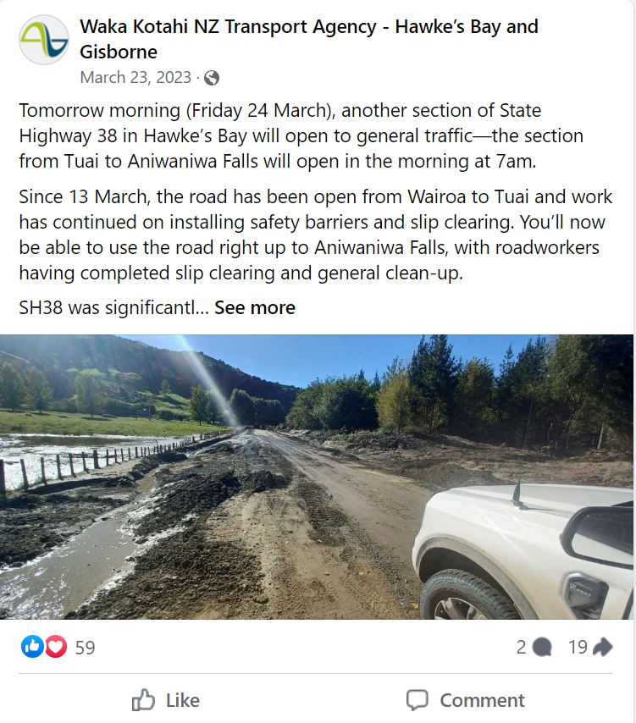
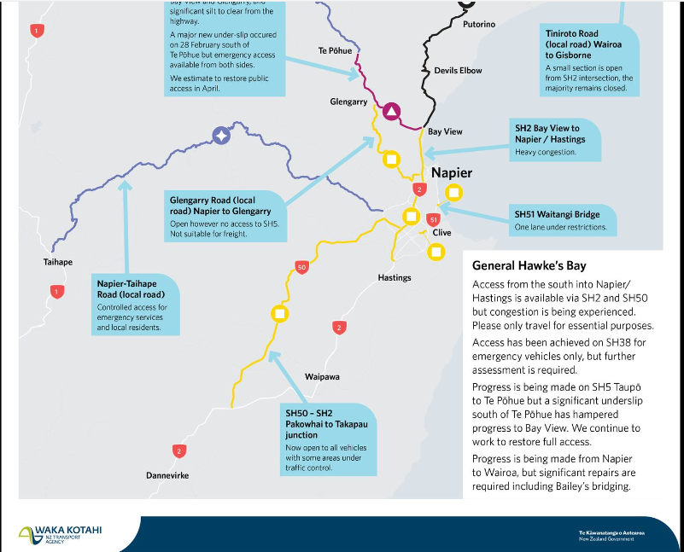
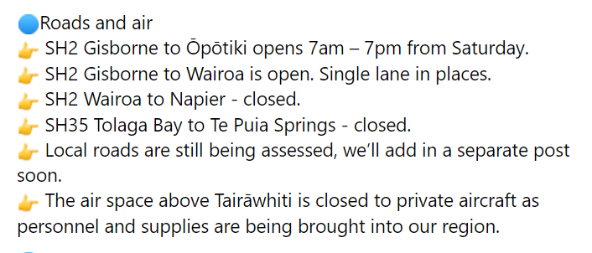

Slide 12
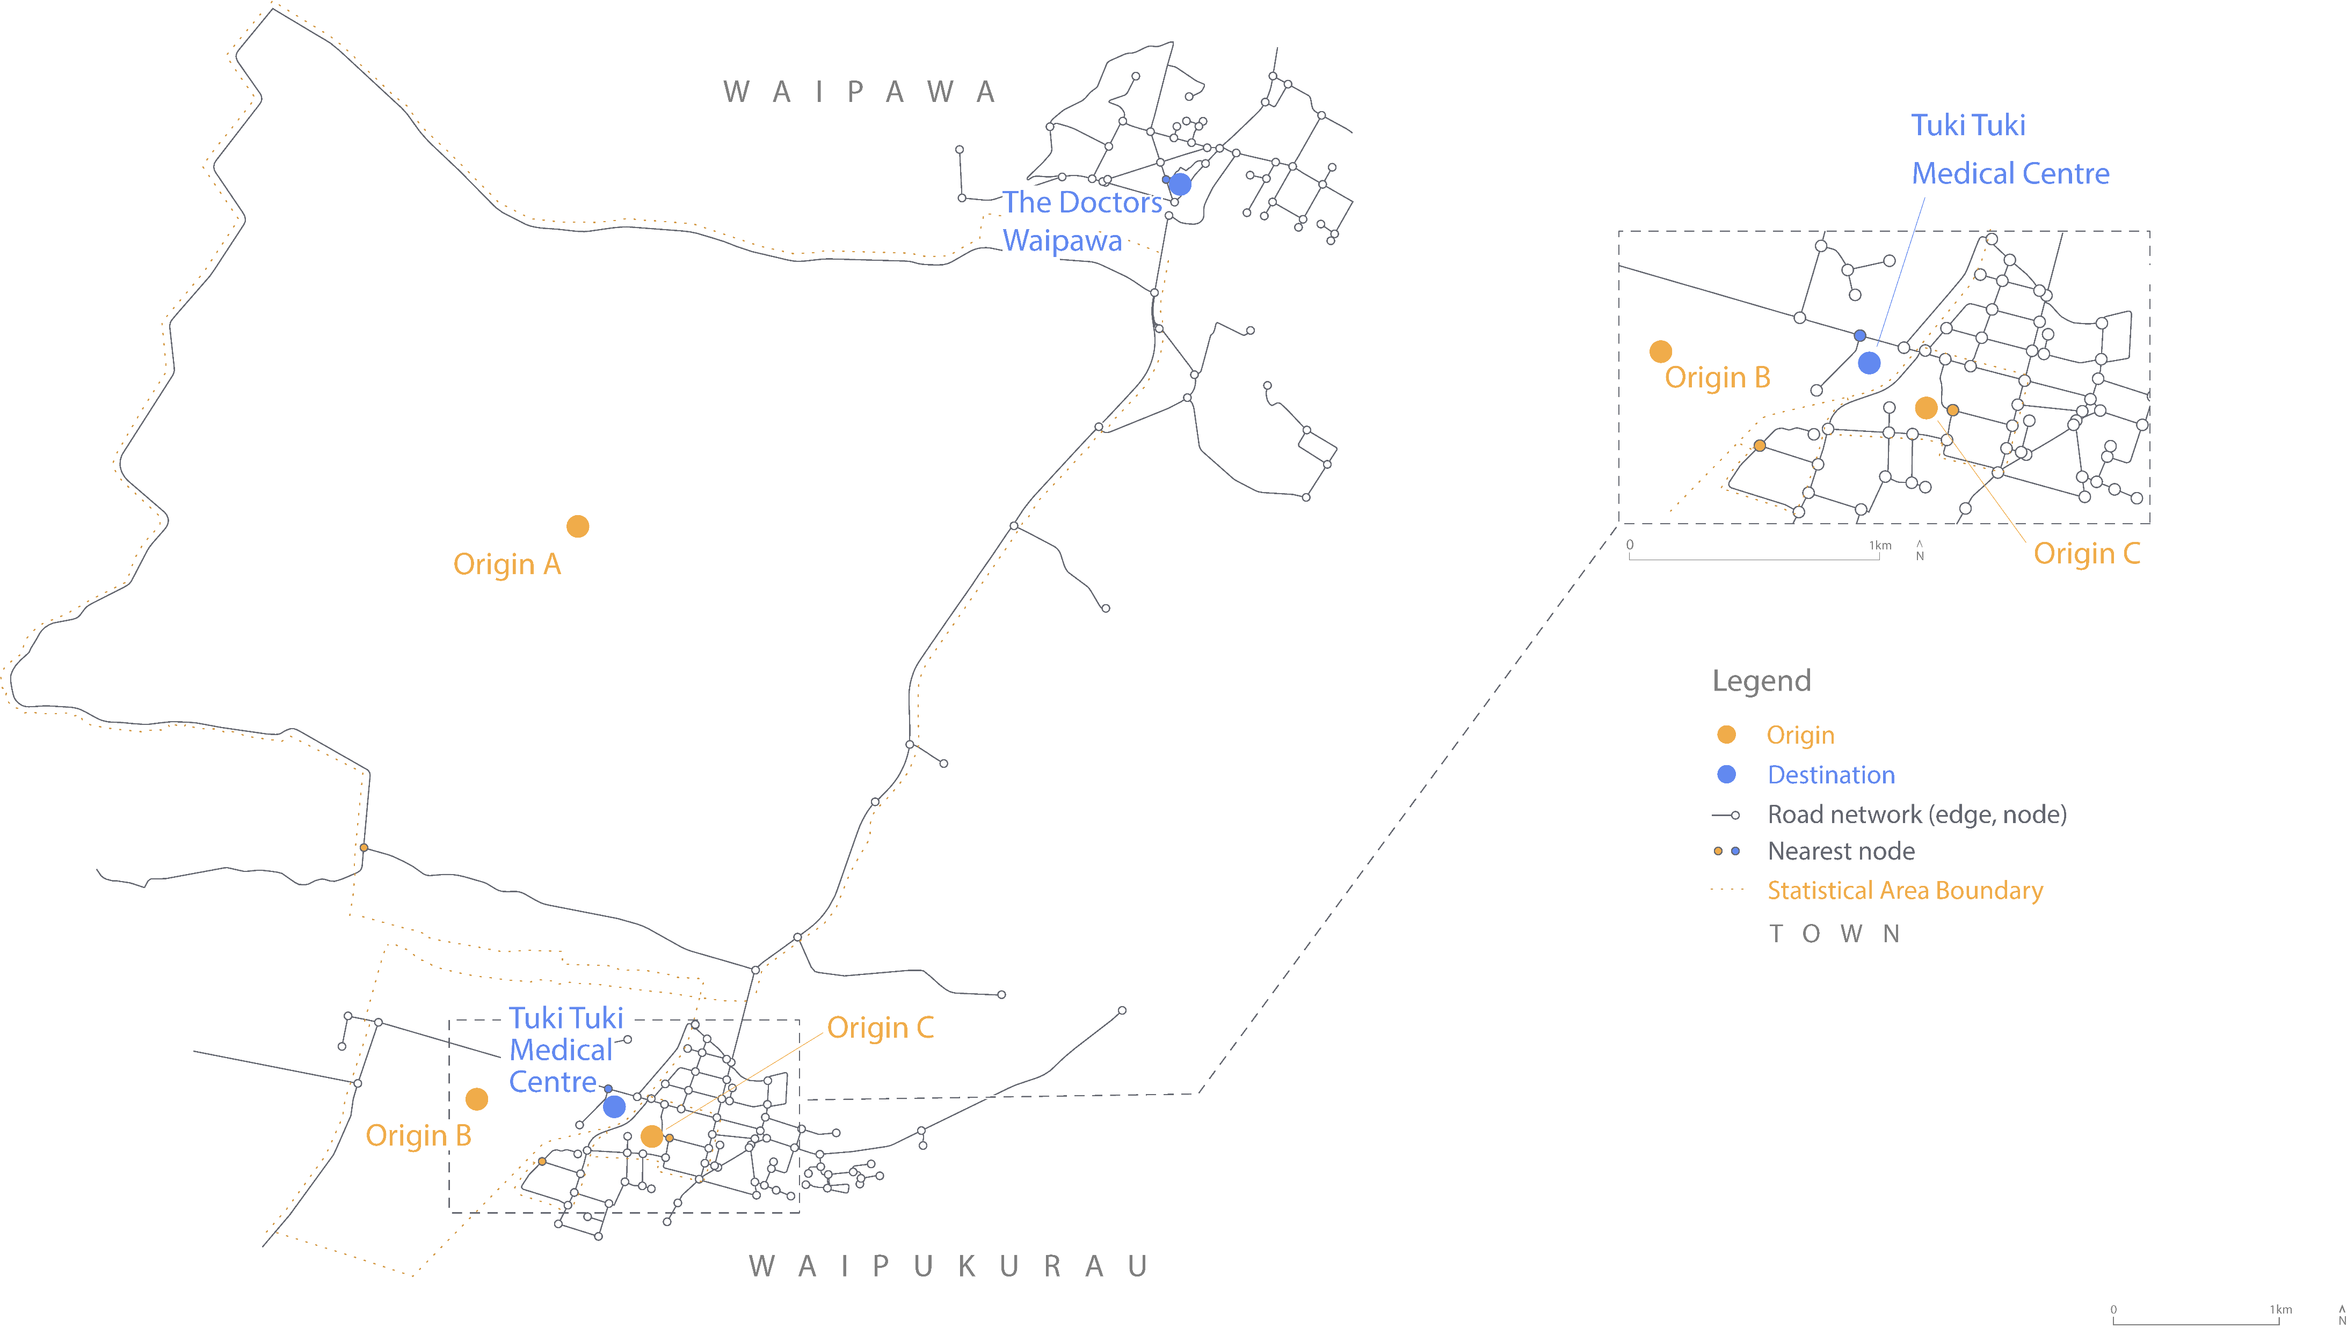

Slide 13
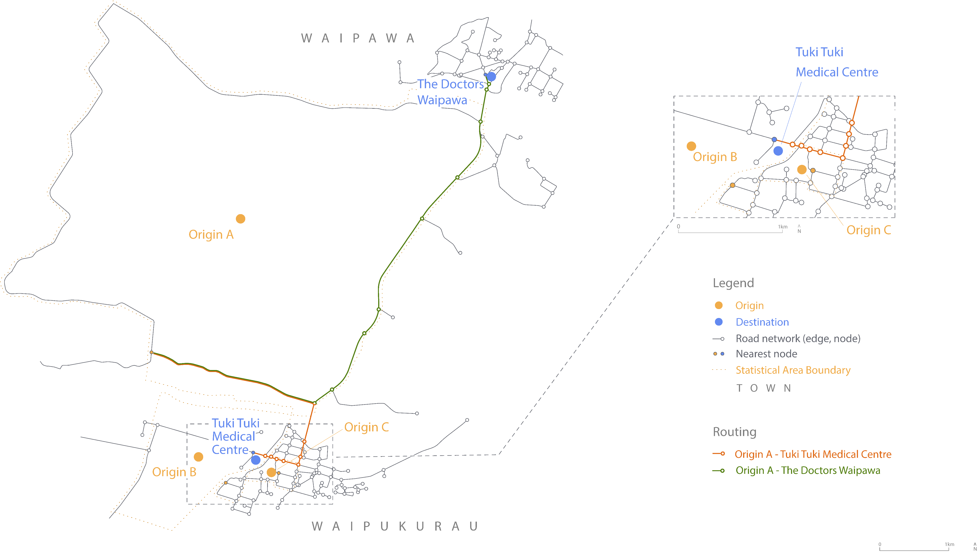

Slide 14
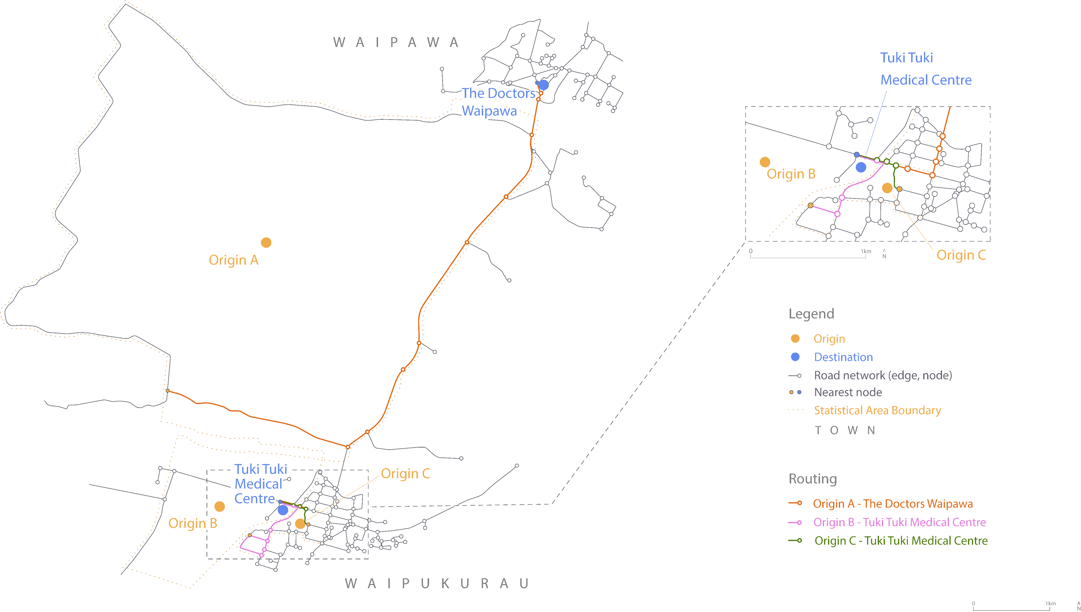

Slide 15
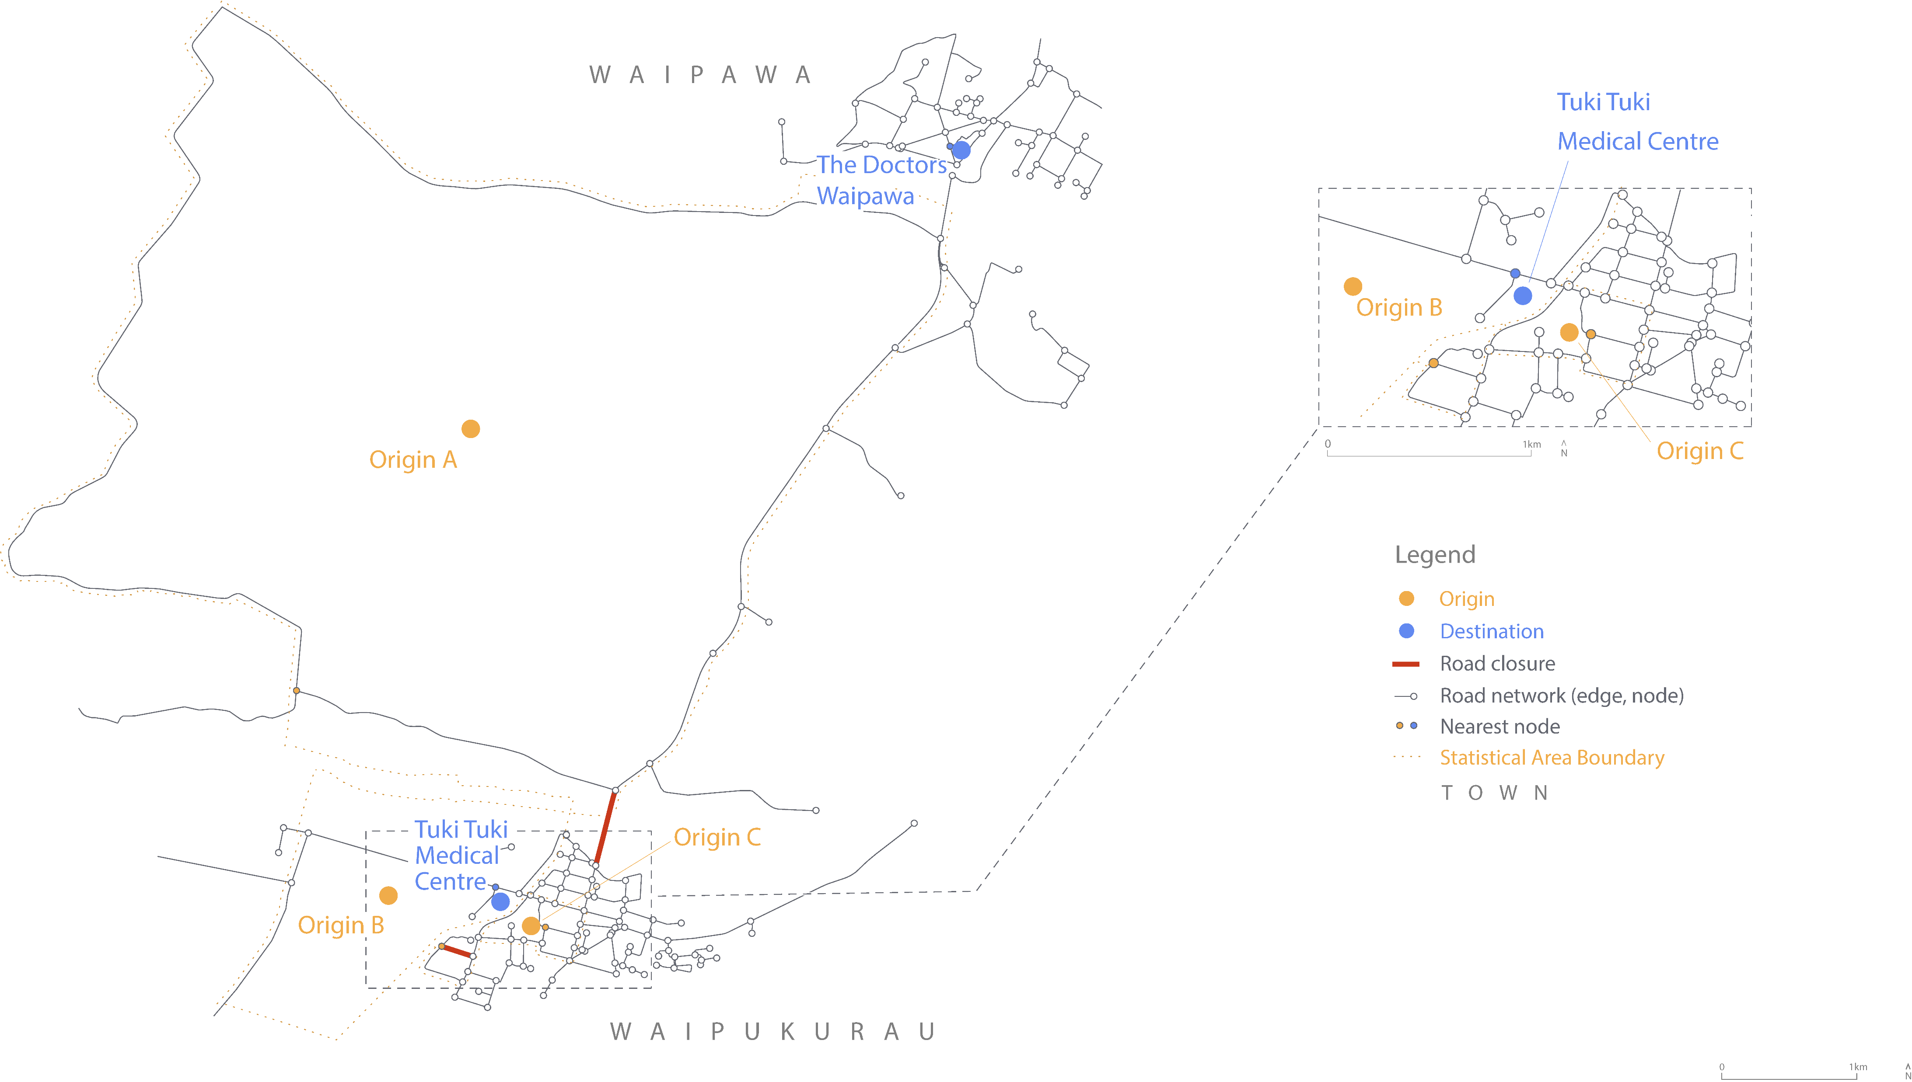

Slide 16
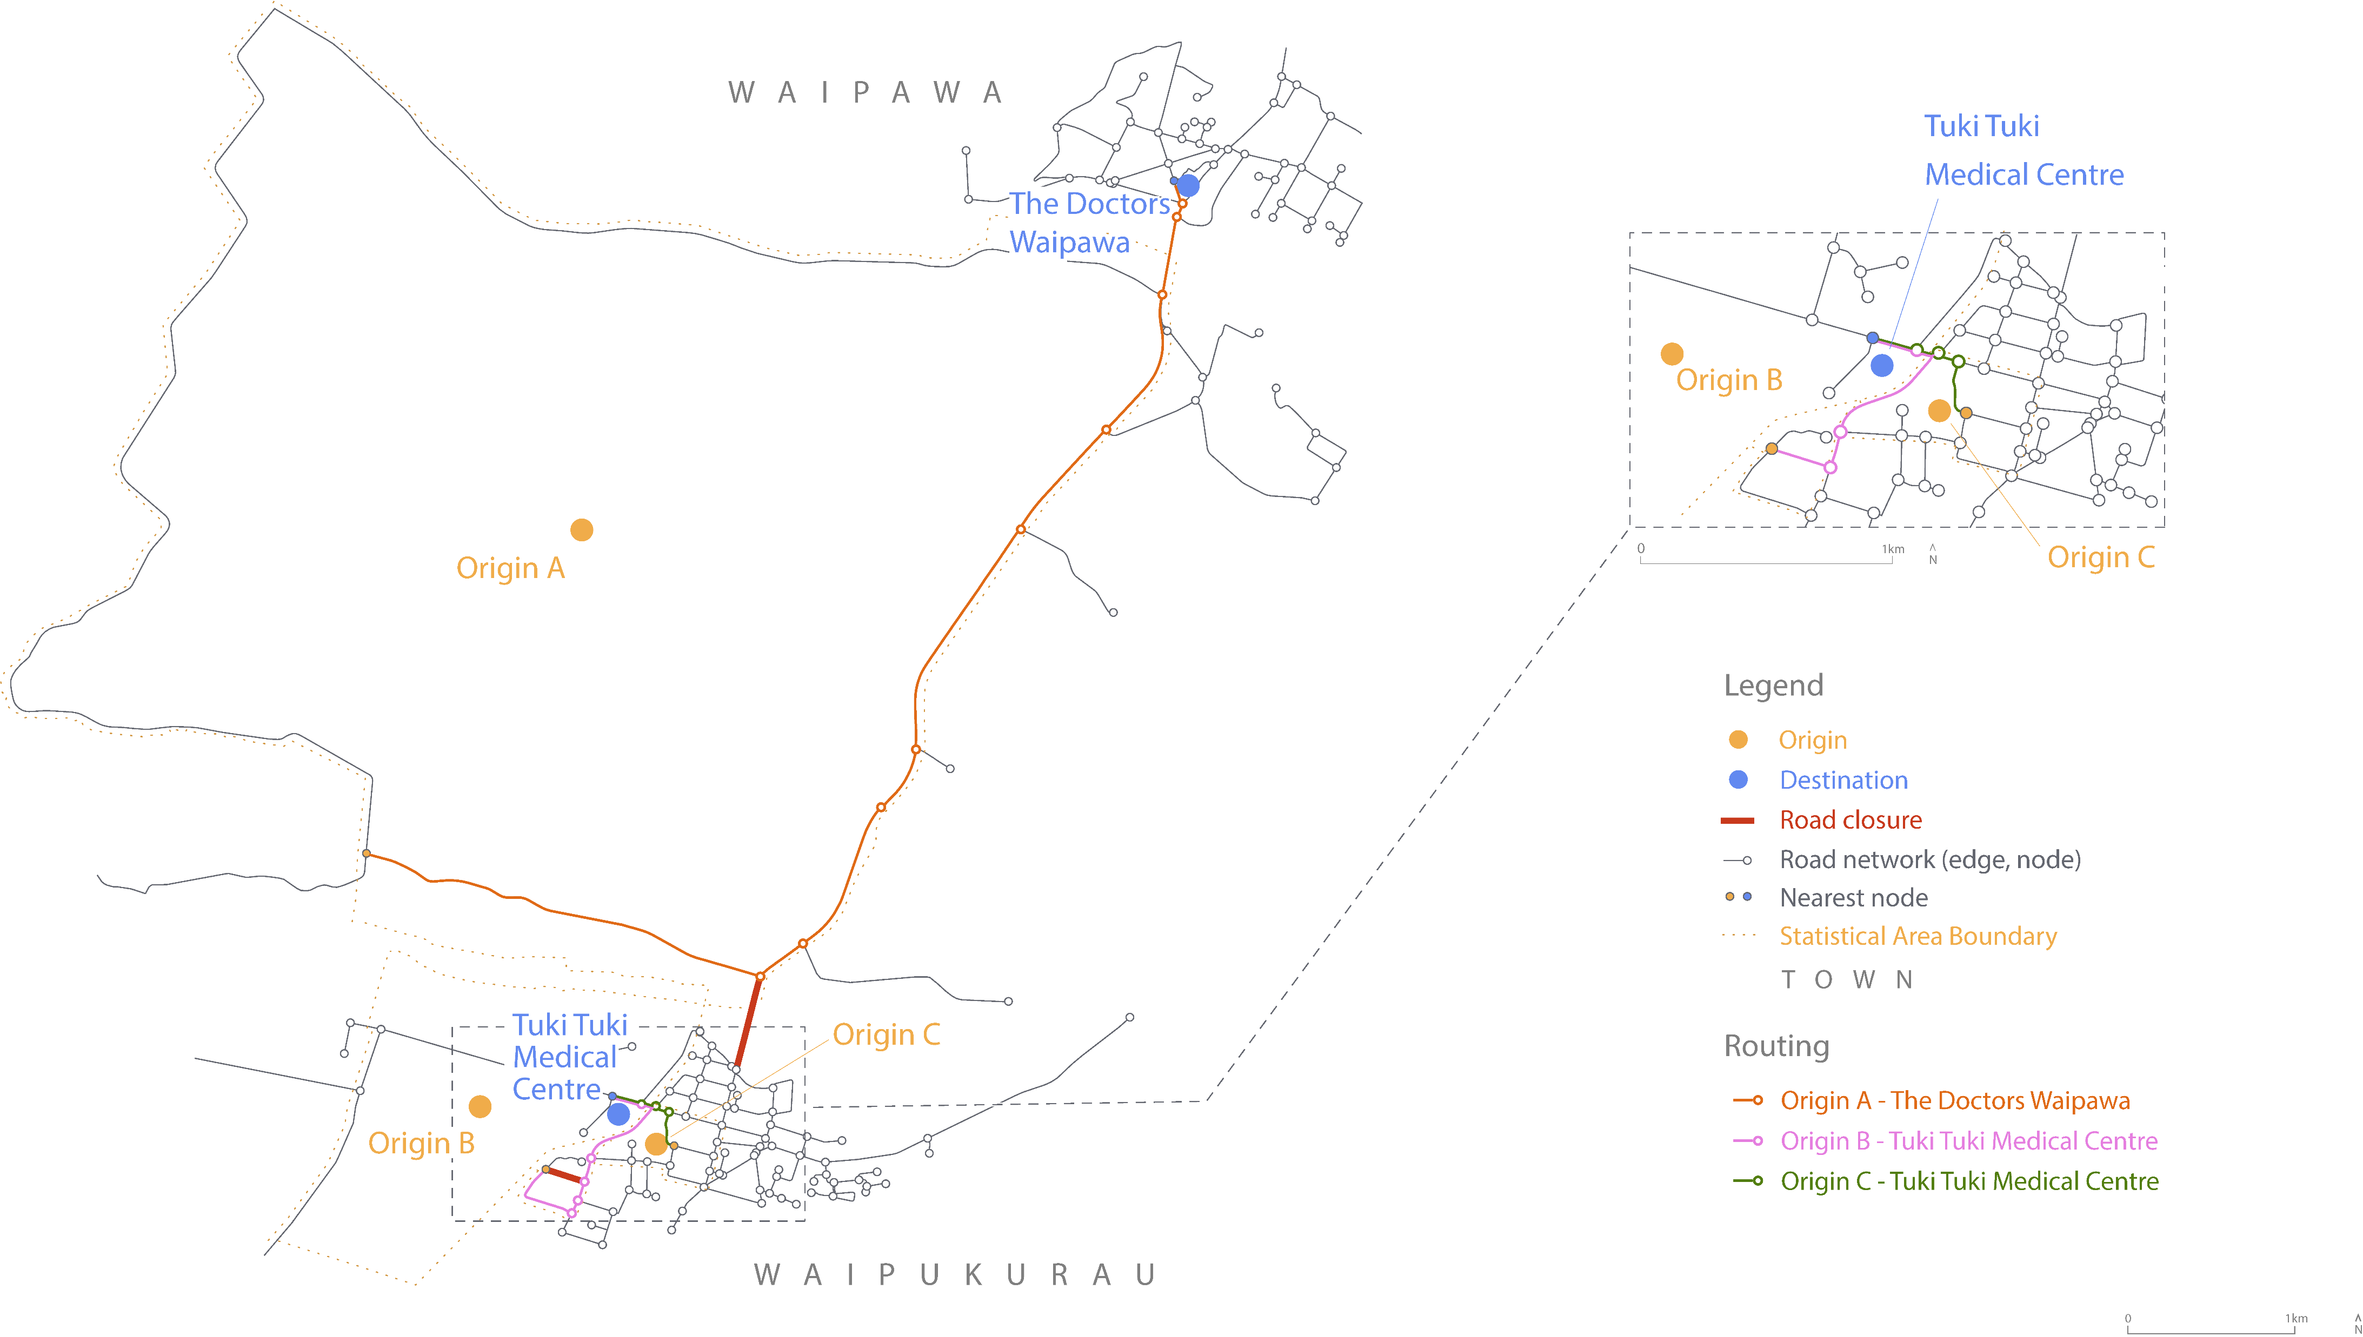

Slide 17
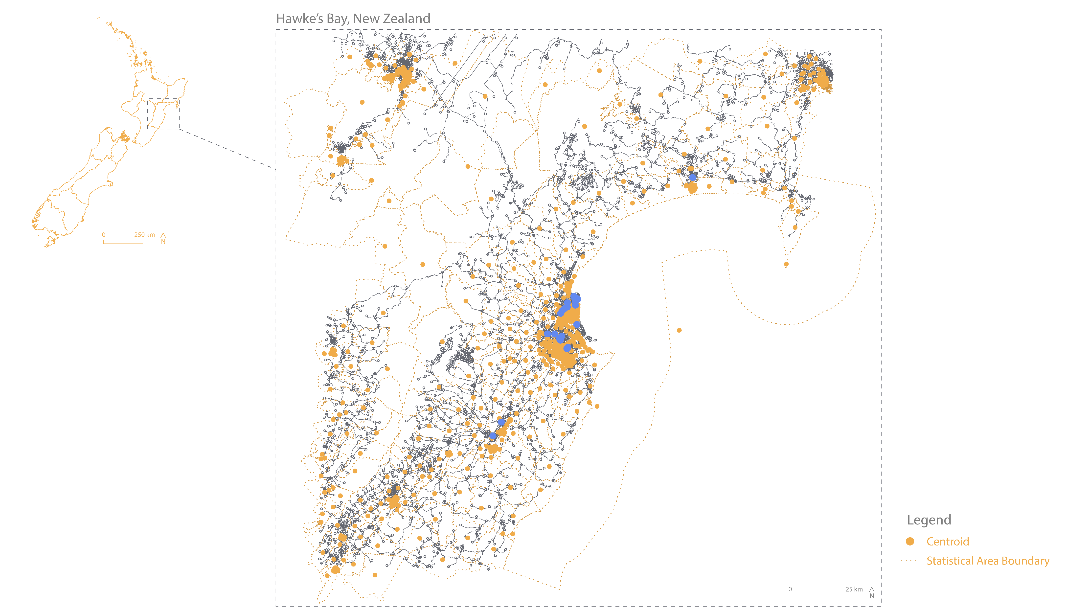

Slide 18
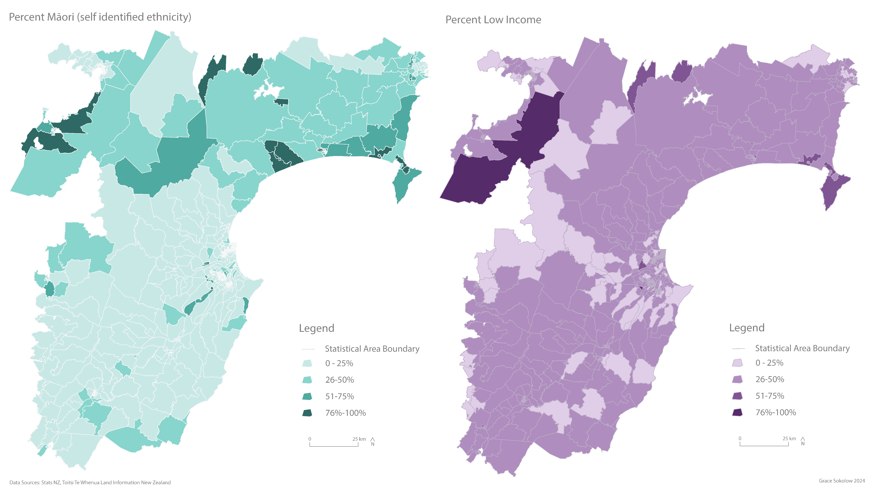

Slide 19
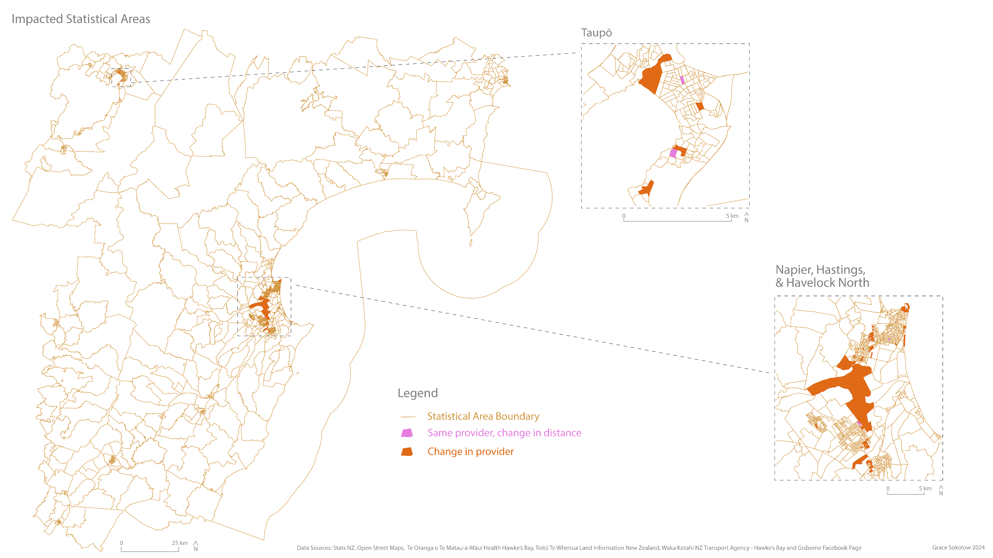

Slide 20
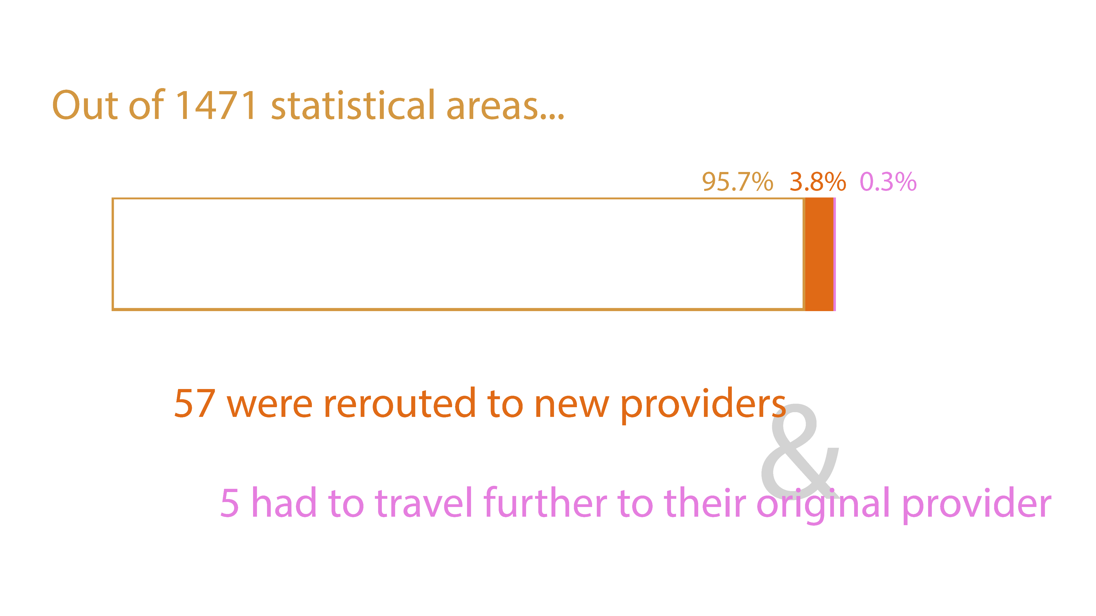

Slide 21
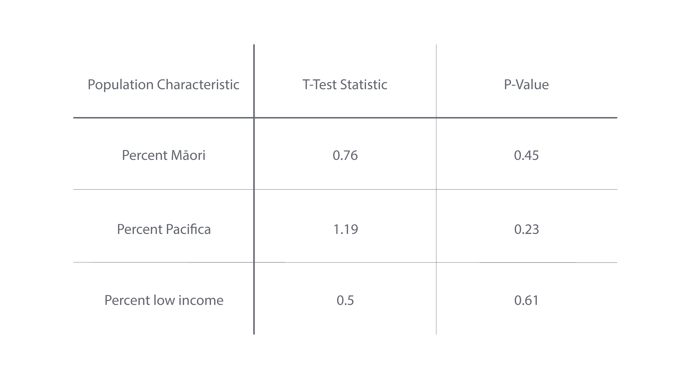

Slide 22
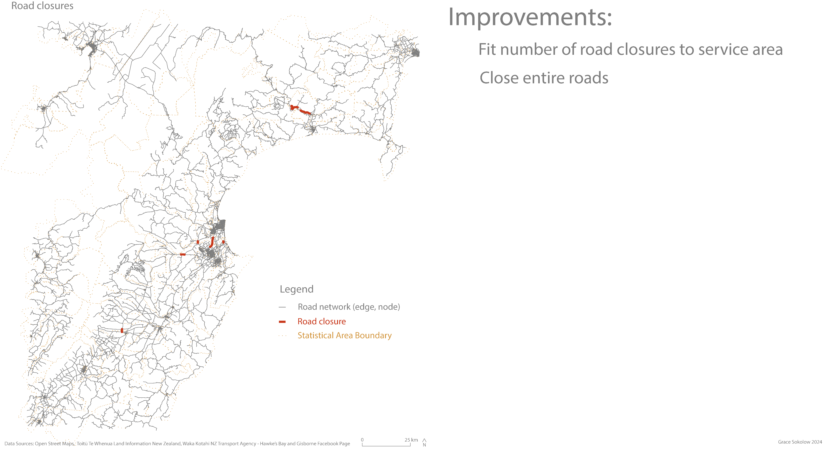

Slide 23
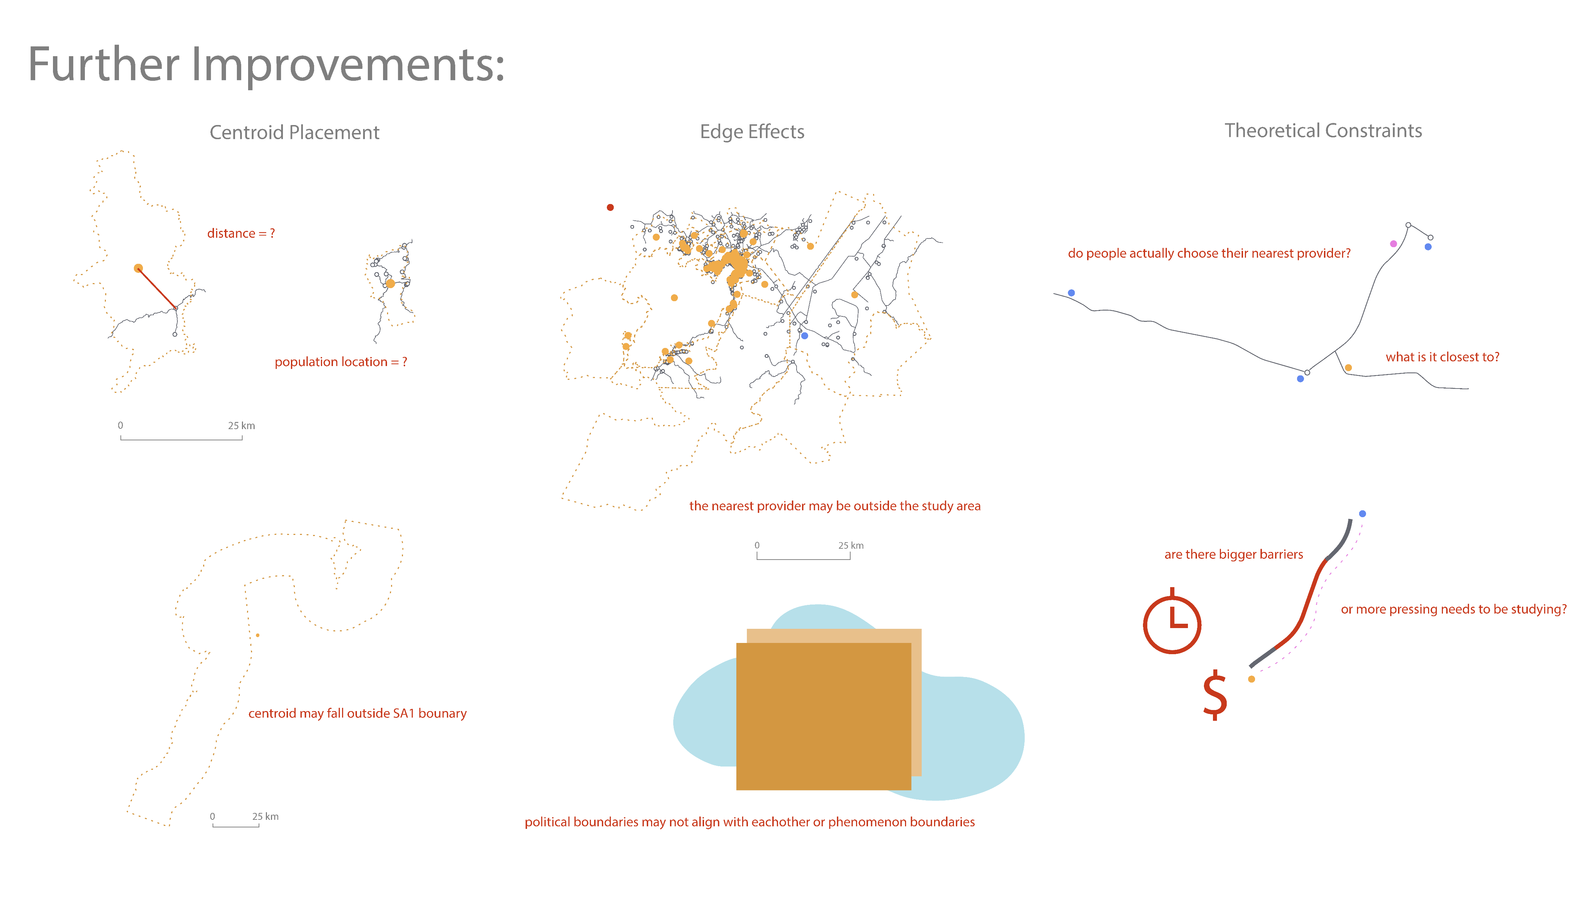

Slide 24
Uses beyond limitations
Varied applications
Road closure modeling in other places/for other storms
Vulnerability testing for specific populations
Modeling access to different amenities on different time scales
Improvements to be made
Calculating travel time rather than distance only
Addressing limitations

Slide 25
Thanks for coming!
Special Thanks to
Pete Nelson
Joe Holler
Caitlyn Myers
Pete Johnson
ALL THE NZ PEOPLE WHO RESPONDED TO ME!
The sandbox crew <3

Slide 26
References

